Slide 1










Slide 2

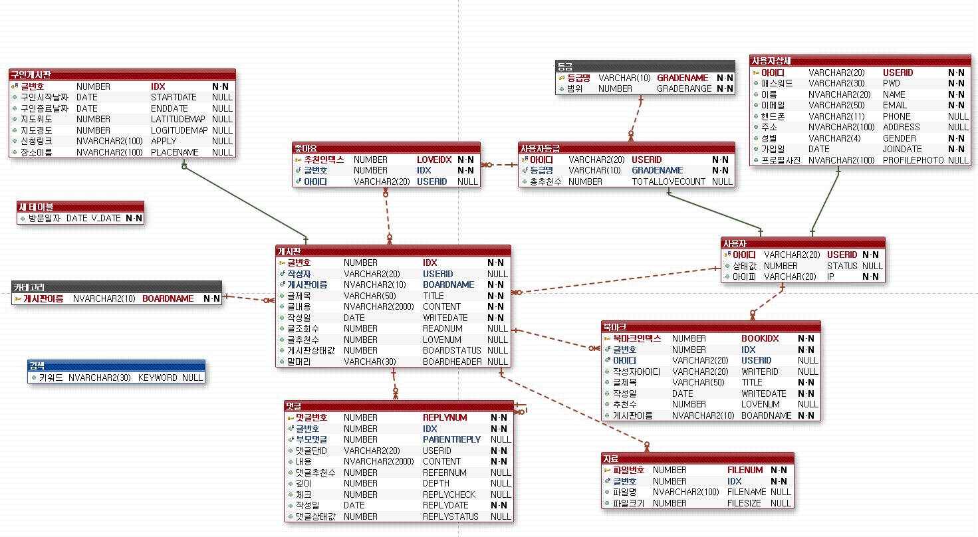

ER 모델 정의

Slide 3


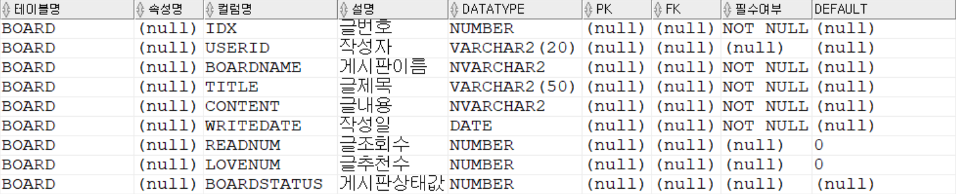
BOARD

Slide 4
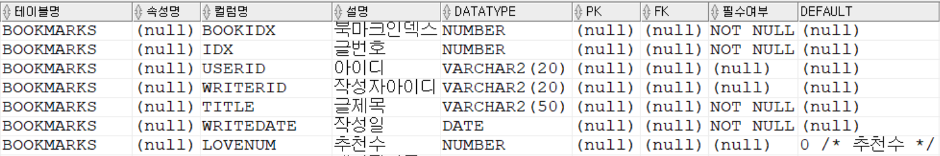
BOOKMARKS

Slide 5
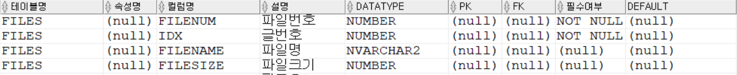
CATEGORY
FILES

Slide 6
FOLLOW
GRADE

Slide 7
LOVE
MEMBER

Slide 8
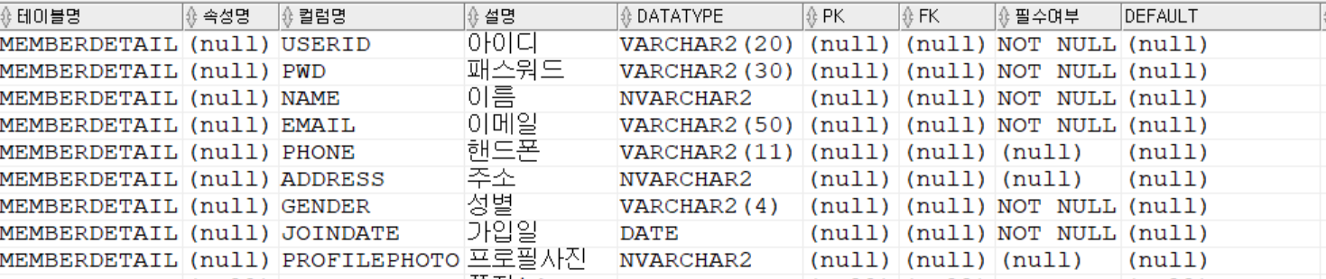
MEMBERDETAIL

Slide 9
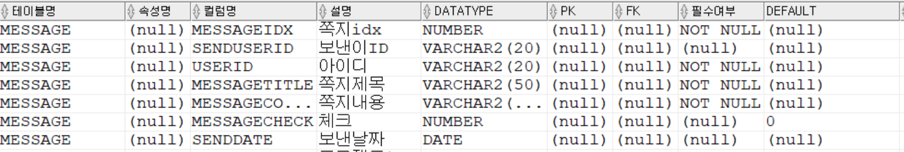
MESSAGE
PROJECT

Slide 10
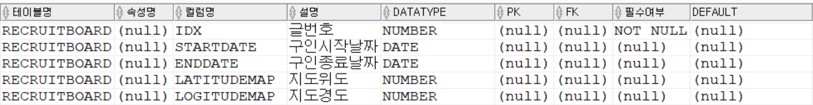
RECRUITBOARD
SEARCH
USERGRADE

Slide 11
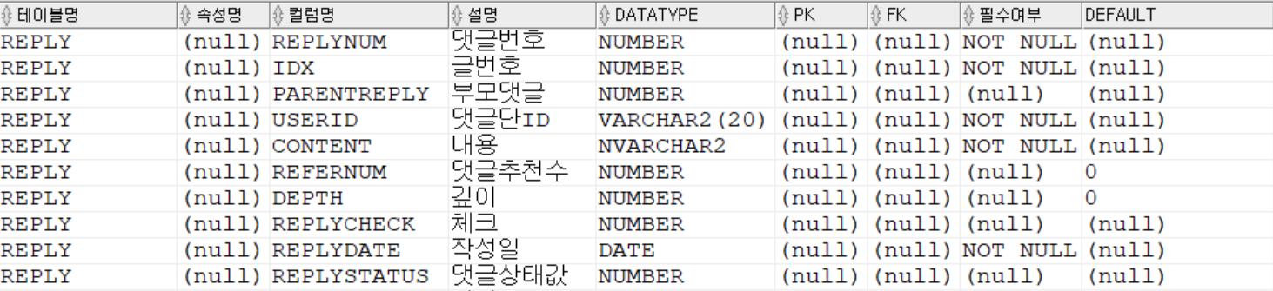
REPLY

